Slide 1
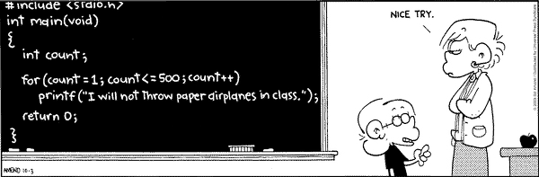
Programming in C
overview
knowledge refreshments

Slide 2

Today
introduction
organisation
programming languages
looking back at C# courses
what is C
include files

Slide 3

Organisation: lectures
preparation at home:
watch the movies youtube (NL)
x hours theory & practical
x hours at your own

Slide 4
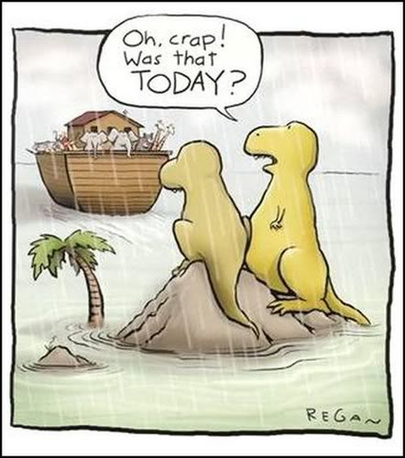
Deadlines...
From the study guide:
practical assignment operate as described:
everything is implemented,
functions are tested well
there are no compiler warnings
submissions:
online via assignments
lecture afterwards: individual questioning
lecture afterwards: class room feedback

Slide 5
Today
introduction
organisation
programming languages
looking back at C# courses
what is C
include files

Slide 6
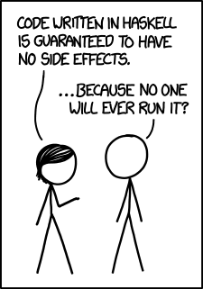
Programming languages
1972 C (Ritchie & Kernighan)
1995 Java
2000 C#

Slide 7
C is an important language!
https://www.tiobe.com/tiobe-index
Notes:
There are lots of “language popularity indexes” out there. The reason this one is particularly interesting for us, is that Tiobe is an Eindhoven based company. Tiobe makes code quality checkers and works with lots of companies in this region. These are the languages that are being used here!

Slide 8
Applications
hardware control (bit operations)
embedded systems → small (memory, cpu speed)
compilers
operating systems

Slide 9
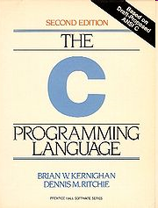
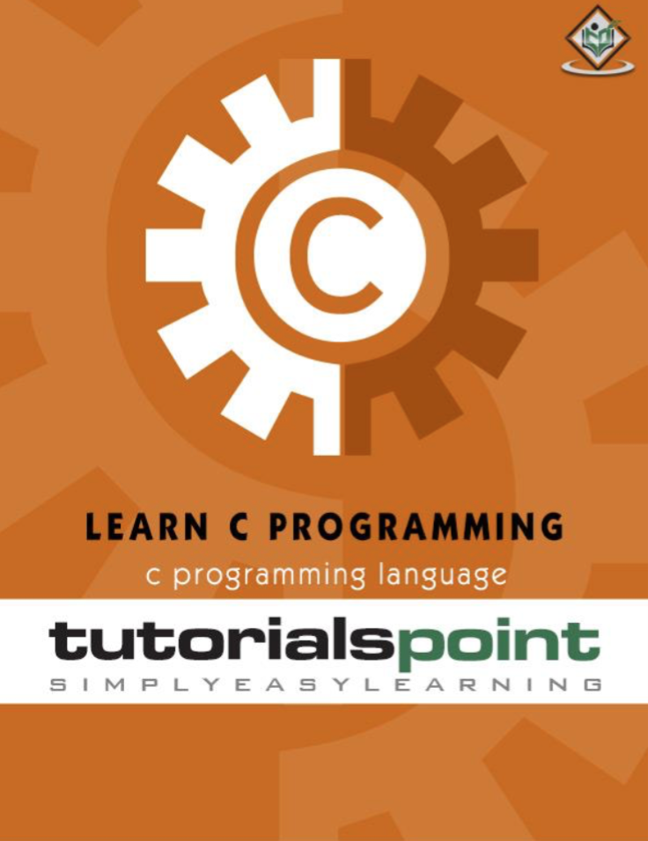
Books
The “C Bible”
Kernighan & Ritchie
Better readable and free
TutorialsPoint

Slide 10
Today
introduction
organisation
programming languages
looking back at C# courses
what is C
include files

Slide 11
Looking back: C#
You have programmed in both C (Arduino) and C#
Let’s compare these languages…

Slide 12
And now C
C is not an OO language, so we don't have classes and objects
we do have methods (but we call them functions)
C runs without ‘runtime environment’
so it has a small footprint
C doesn't check you
therefor fast, but sometimes more dangerous!
Interesting document: The Descent to C
Notes:
The Descent to C is an article written for people who are used to “higher” languages such as C# and Java. It gives a lot of insight into ‘why’ certain choices have been made.

Slide 13
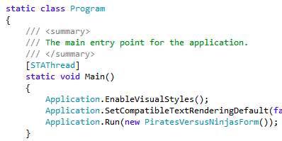
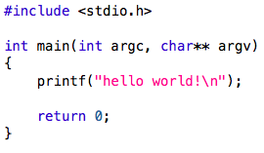
But what is C?
C#:
C:
Notes:
Both C# and C start their program in a ”main” function
Beware: on an Arduino, this main function is hidden, it looks something like this:
int main()
{
setup();
while(true)
{
loop();
}
return 0;
}

Slide 14
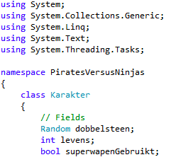
But what is C?
C#:
C:

Slide 15
Your first C program...
& runs the program in the background such that you can use the terminal for next commands
create a new text file:
on the command line: geany hello.c &
add the following text:
#include <stdio.h>
int main(void)
{
printf("hello world!\n");
return 0;
}
save and type on the command line: make hello
then: ./hello
no .c extension!
You build program hello,
make is smart enough to find file hello.c
./ because the current dir is not in your path
Notes:
./: in contrary to what you are used to on the Windows commandline, in Linux . (your current directory) is not added to the path.
This is done for security reasons, more information:
http://superuser.com/questions/350844/how-to-permanently-add-current-directory-to-path-in-linux/350847#350847 (especially the first 2 reactions to the answer)

Slide 16
Comparison with C#
C#:
variables: int, char, double
variables: string, bool
test: if
loops: for, while, do..while, foreach
methods
classes
C:
variables: int, char, double
no ‘real’ string or bool
test: if
loops: for, while, do..while
no foreach
functions (is the same*)
no classes, ...
less ‘automatic’ stuff done for you
* see speaker notes
Notes:
Technically this is not entirely correct: a method is a “function inside a class”. The difference is that a method needs a link to your current object: ‘this’, which is a (usually hidden) first parameter in a method.

Slide 17
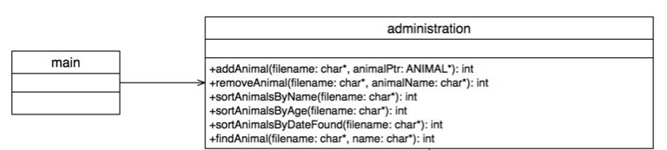
And your other knowledge?
You might have seen class diagrams before
Class diagrams show:
different blocks (classes) with certain code/functionality
which blocks can “talk” to which blocks
in C, such a block is a file (or module)
the compiler brings those files together into 1 program
Notes:
Later in the T curriculum it is useful when you think of “blocks of functions” when developing a system. Such a block can be hardware or it can be software (a class, a module, a library, …). That’s the reason we simply use “class” diagrams in this course as well: to push you into working in smaller parts rather than one big whole.
Obviously: from a purist UML standpoint this is completely wrong: a class is a CLASS and nothing else. The practical point of view: you often think about how to develop your system, how to divide that whole into smaller blocks. In those cases you must use something to document what you are doing, why not use something you are learning in anyway (this semester in C#, later in C++).

Slide 18
Several files for 1 program?
"Houston, we have a problem":
in C, the compiler only works top-down
it only knows what it has seen until now
so this will not work:
#include <stdio.h>
int main(void) { printHello(); return 0; }
void printHello(void) { printf("hello world!\n"); }
compiler: "what is this?"
Notes:
The compiler will complain as follows:
warning: implicit declaration of function ‘printHello’

Slide 19
Function prototypes
How to solve?
#include <stdio.h>
void printHello(void);
int main(void)
{
printHello();
return 0;
}
void printHello(void)
{
printf("hello world!\n");
}
function prototype
"I recognize this function, so I know what to do with it"

Slide 20
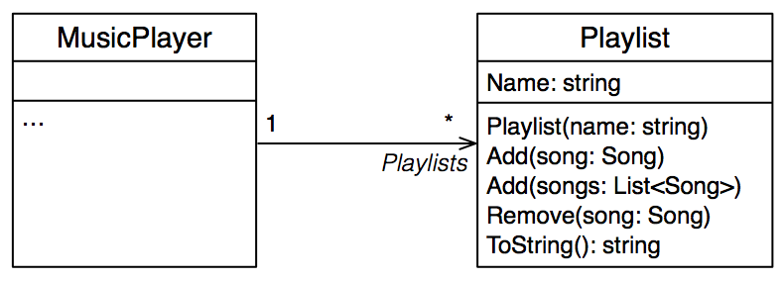
Grouping function prototypes
"do I have to write all prototypes where I want to use them?"
No: put them in Playlist.h
with ‘multiple include’ security!
And add before using : #include “Playlist.h”
note the difference between <Playlist.h> and “Playlist.h”
Notes:
This is an example from OOP2
Multiple include security: https://en.wikipedia.org/wiki/Include_guard

Slide 21
.c and .h files
playlist.h:
#ifndef PLAYLIST_H
#define PLAYLIST_H
int GetNrOfSongs(void);
... // other prototypes
#endif
main.c:
#include "playlist.h"
int main(void)
{
int n;
n = GetNrOfSongs();
...
}
playlist.c:
#include "playlist.h"
int GetNrOfSongs(void)
{
...
// full implementation
}
...
// other function
// implementations

Slide 22
